Slide 1
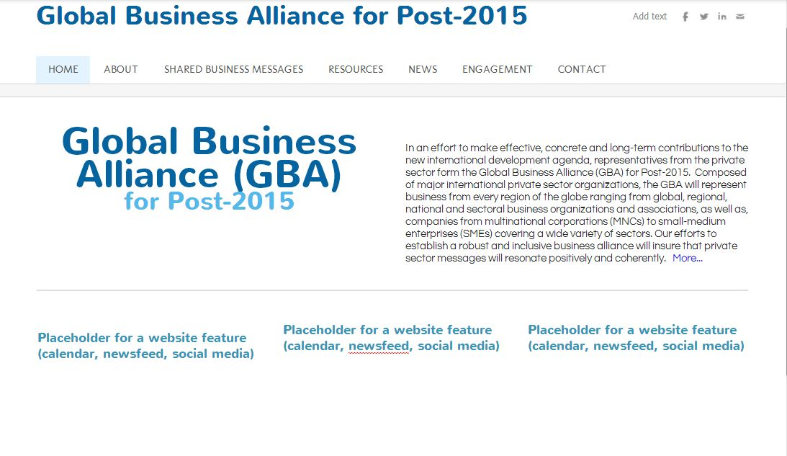
Page 1 - GBA Homepage
This link re-directs to the “About” page
These are placeholders for additional homepage features such as RSS newsfeed, calendar, contact information, etc.

Slide 2
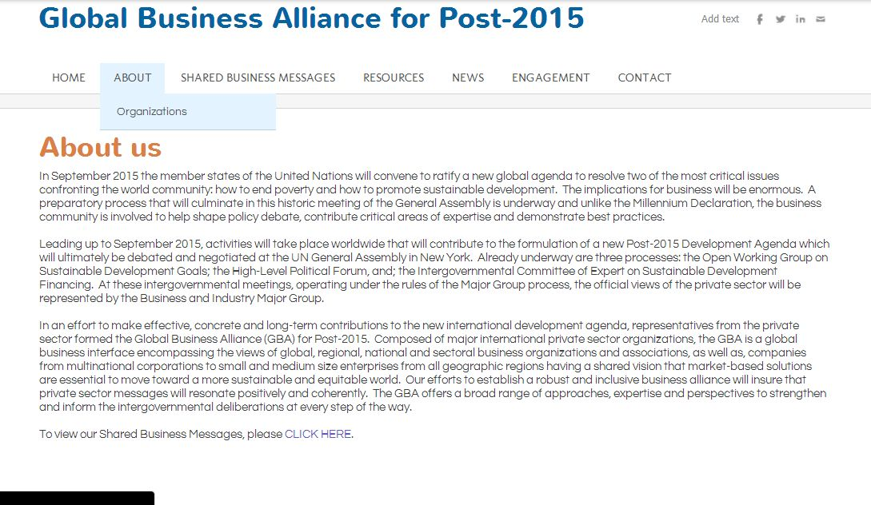
Page 2 - About page

Slide 3

Page 2.1 - List of organizations (links to respective org website)

Slide 4

Page 3.1 - Shared Business Messages

Slide 5
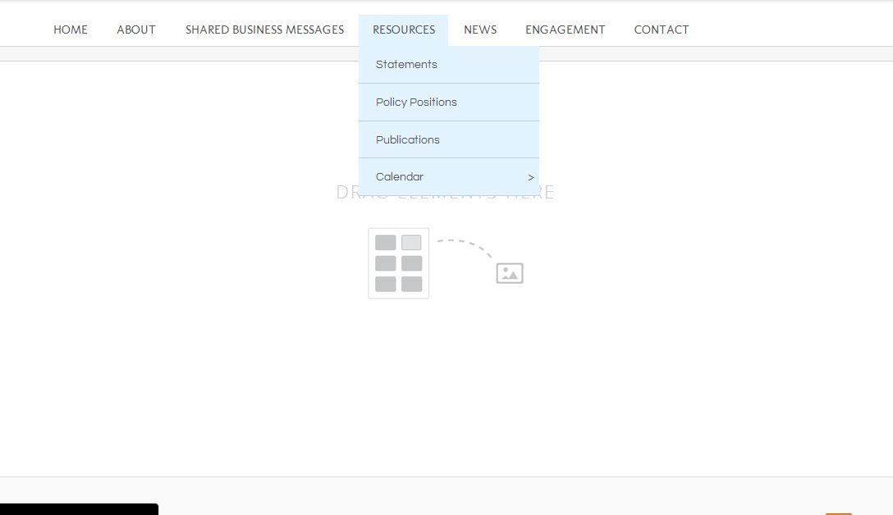
Page 4 - Resources
This page is currently blank but could include headlines to latest statements, policy positions, publications, etc.
Sub-sections on “Policy positions” and “publications” are currently blank as well and could be removed from the drop down options until content becomes available.

Slide 6
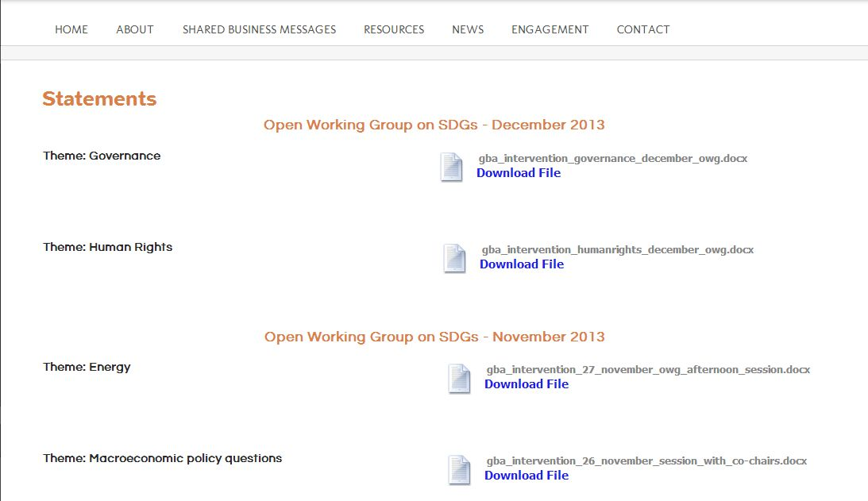
4.1 - Statements

Slide 7
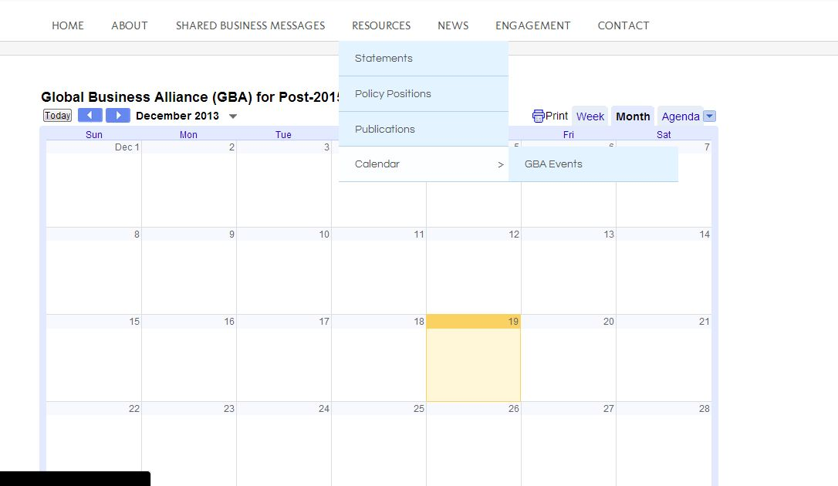
4.2 - Calendar
This calendar is linked to a Google Calendar for GBA. This has a list of upcoming meetings and events that will be updated over time. The subcategory “GBA Events” would list all upcoming and past GBA organized events.

Slide 8
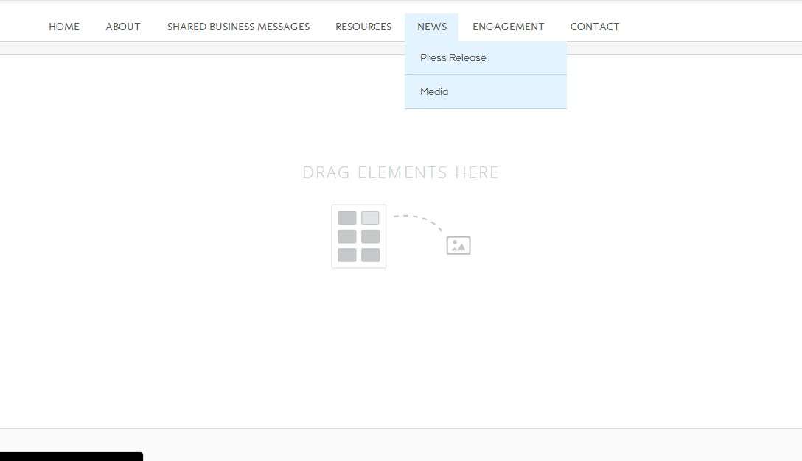
Page 5 - News
“News” homepage is currently blank but could include headlines on latest press releases, activities, reports, events, etc.

Slide 9
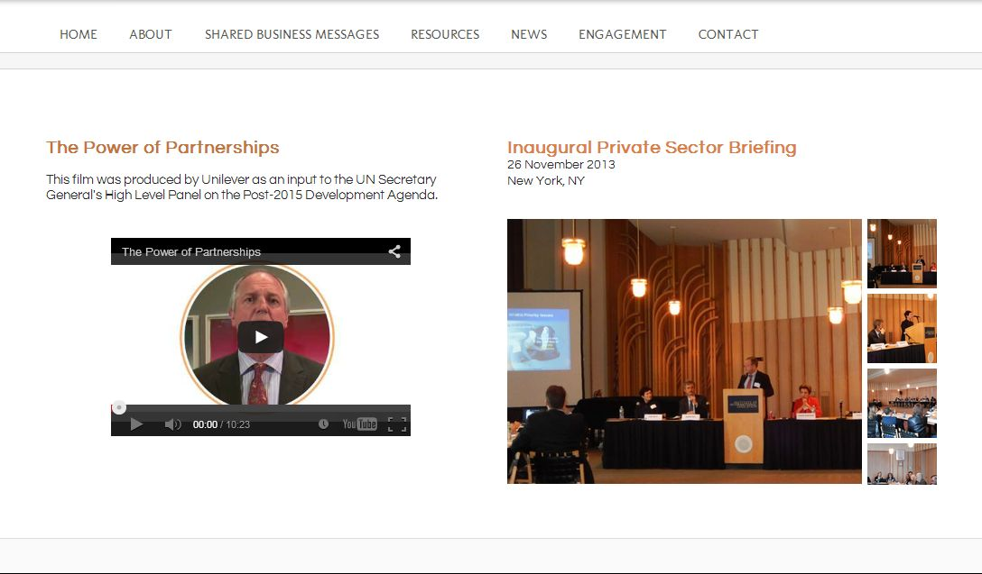
Page 5.1 – Media (“News” subpage)
The media page would contain photo galleries, video and audio clips of GBA related activities

Slide 10
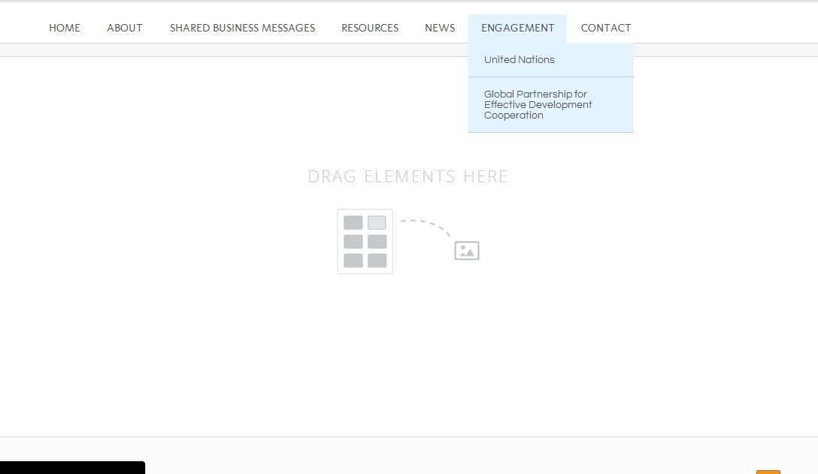
Page 6 - Engagement
Currently blank but could include information on how the GBA is engaging in the different intergovernmental processes. Under “United Nations” we could add subpages on OWG, Financing, as well as other intergovernmental processes that will take place in the near future.

Slide 11
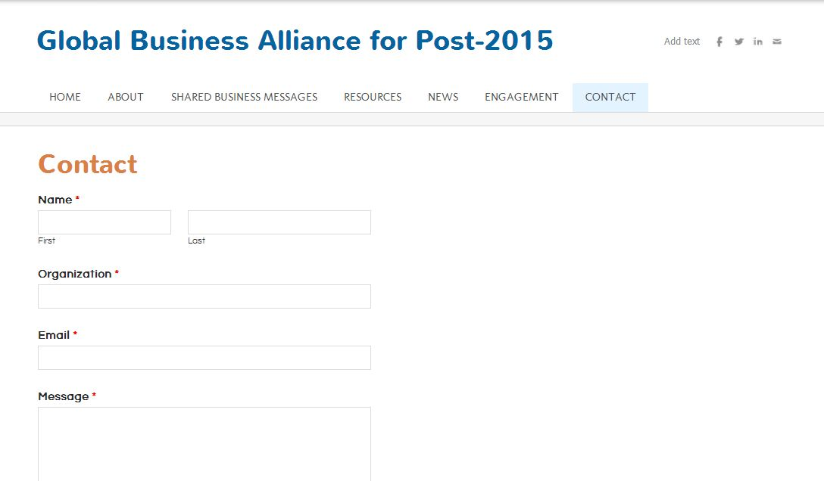
Page 7 - Contact
Currently, this only has a contact form. If the GBA gets its own domain name, we could have a separate email address that could point to Lea’s email. Relevant information communicated through this form could then be disseminated to the group for specific responses.

